Slide 1
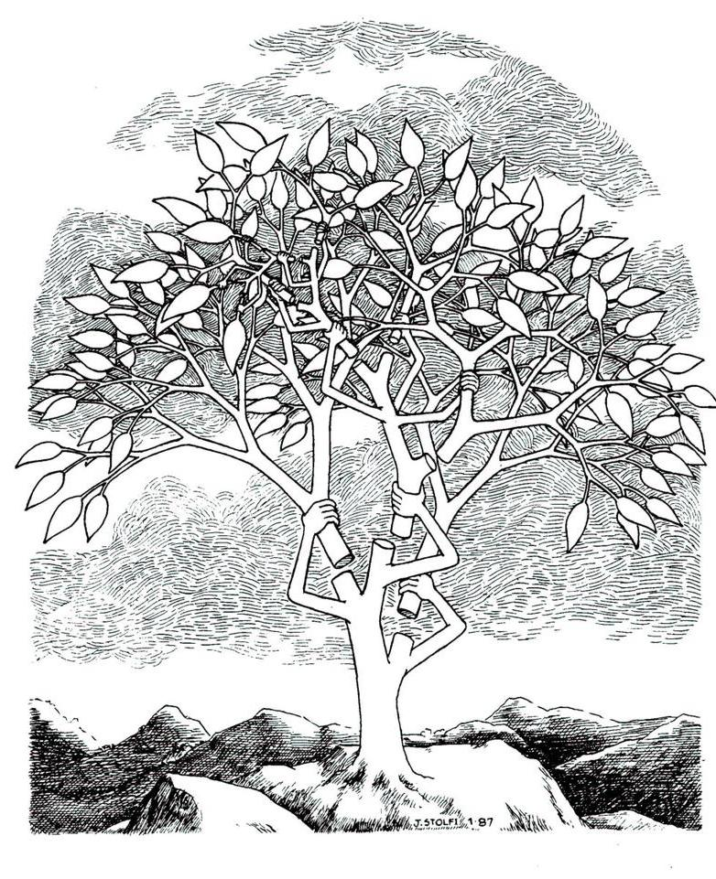
Self-Adjusting Data Structures

Slide 2
Self-Adjusting Data Structures
2
7
4
1
9
5
3
move-to-front
Search(2), Search(2), Search(2) , Search(5), Search(5), Search(5)
5
2
7
4
1
9
3
Lists [D.D. Sleator, R.E. Tarjan, Amortized Efficiency of List Update Rules, Proc. 16th Annual ACM Symposium on Theory of Computing, 488-492, 1984]
Dictionaries [D.D. Sleator, R.E. Tarjan, Self-Adjusting Binary Search Trees, Journal of the ACM, 32(3): 652-686, 1985] → splay trees
Priority Queues [C.A. Crane, Linear lists and priority queues as balanced binary trees, PhD thesis, Stanford University, 1972] [D.E. Knuth. Searching and Sorting, volume 3 of The Art of Computer Programming, Addison-Wesley, 1973] → leftist heaps
[D.D. Sleator, R.E. Tarjan, Self-Adjusting Heaps, SIAM Journal of Computing, 15(1): 52-69, 1986] → skew heaps
[C. Okasaki, Alternatives to Two Classic Data Structures, Symposium on Computer Science Education, 162-165, 2005] → maxiphobix heaps
Okasaki: maxiphobix heaps are an alternative to leftist heaps ... but without the “magic”

Slide 3
3
Heaps
(via Binary Heap-Ordered Trees)
2
2
2
5
3
MakeHeap, FindMin, Insert, Meld, DeleteMin
1
1
1
1
=
=
Meld Cut root + Meld
7
9
4
6
Leftist Heaps
1
2
[C.A. Crane, Linear lists and priority queues as balanced binary trees, PhD thesis, Stanford University, 1972] [D.E. Knuth. Searching and Sorting, volume 3 of The Art of Computer Programming, Addison-Wesley, 1973]
12
8
2
1
3
11
10
2
1
1
3
13
13
2
4
2
3
3
Meld ( , ) =
merge rightmost paths
Each node distance to empty leaf
Inv. Distance right child ≤ left child
rightmost path ≤ ⎡log n+1⎤ nodes
4
2
2
7
1
2
2
2
13
2
7
4
9
1
1
1
4
9
1
13
Time O(log n)
1
1
Maxiphobic Heaps
[C. Okasaki, Alternatives to Two Classic Data Structures, Symposium on Computer Science Education, 162-165, 2005]
Meld ( , )
x
y
x
T₃
= Meld ( , )
T₁
T₂
T_{i}
T_{j}
T_{k}
Max size n → ⅔n
x < y
Time O(log_{3/2} n)
largest size
two smallest
Notes:
Okasaki: Using minimal height instead of size always works => 2log n recursive calls (sum of height of the two merged trees decreases by one for each recursive call)

Slide 4
Skew Heaps
[D.D. Sleator, R.E. Tarjan, Self-Adjusting Heaps, SIAM Journal of Computing, 15(1): 52-69, 1986]
2
Heap ordered binary tree with no balance information
MakeHeap, FindMin, Insert, Meld, DeleteMin
Meld = merge rightmost paths + swap all siblings on merge path
5
3
7
9
4
6
=
=
12
8
Meld Cut root + Meld
10
2
v heavy if |T_{v}| > |T_{p(v)}|/2, otherwise light
any path ≤ log n light nodes
Potential Φ = # heavy right children in tree
Meld ( , ) =
4
4
2
merge rightmost paths
13
7
7
9
9
13
O(log n) amortized Meld
Heavy right child on merge path before meld → replaced by light child
⇒ 1 potential released for heavy node
⇒ amortized cost 2∙ # light children on rightmost paths before meld
Notes:
Maxiphobic & leftist trees requires an integer field in each node – skew heaps don’t require this.
Saves space, but uses more time for rebalancing.

Slide 5
Skew Heaps – O(1) time Meld
[D.D. Sleator, R.E. Tarjan, Self-Adjusting Heaps, SIAM Journal of Computing, 15(1): 52-69, 1986]
Meld = Bottom-up merg of rightmost paths + swap all siblings on merge path
1
1
not touched
Meld ( , ) =
=
4
1
2
3
2
5
13
3
2
4
6
4
8
6
7
7
11
previously minor
major
merge rightmost paths
5
11
9
9
8
minor
13
Φ = # heavy right children in tree + 2 ∙ # light children on minor & major path
O(1) amortized Meld
Heavy right child on merge path before meld → replaced by light child ⇒ 1 potential released Light nodes disappear from major paths (but might → heavy) ⇒ ≥ 1 potential released
and become a heavy or light right children on major path ⇒ potential increase by ≤ 4
O(log n) amortized DeleteMin
Cutting root ⇒ 2 new minor paths, i.e. ≤ 2∙log n new light children on minor & major paths
4
5

Slide 6
Splay Trees
[D.D. Sleator, R.E. Tarjan, Self-Adjusting Binary Search Trees, Journal of the ACM, 32(3): 652-686, 1985]
Binary search tree with no balance information
splay(x) = rotate x to root (zig/zag, zig-zig/zag-zag, zig-zag/zag-zig)
Search (splay), Insert (splay predecessor+new root), Delete (splay+cut root+join), Join (splay max, link), Split (splay+unlink)
root
z
zig-zig
x
z
zig-zag
y
zig
x
x
C
A
y
D
A
y
y
D
x
y
C
y
z
A
B
B
C
x
B
z
A
x
A
B
C
D
A
B
C
D
B
C
v
zag-zag zig-zig
x
u
F
insert
x
u
z
E
y
u
y
D
v
A
y
z
C
D
v
E
F
B
x
A
B
E
F
z
C
C
D
A
B
Notes:
splay = ”sprede ud”

Slide 7
Splay Trees
[D.D. Sleator, R.E. Tarjan, Self-Adjusting Binary Search Trees, Journal of the ACM, 32(3): 652-686, 1985]
The access bounds of splay trees are amortized
(1) O(log n)
(2) Static optimal
(3) Static finger optimal
(4) Working set optimal (proof requires dynamic change of weight)
Static optimality: Φ = _{v} log |T_{v}|
Σ
Notes:
splay = ”sprede ud”

